Slide 1
WINE QUALITY PREDICTION WITH MACHINE LEARNING
TEAM MEMBERS
1)MIKKILINENI LEKHANA SAI
2)HARITHA CHENNURU VENUGOPAL REDDY
3)PRANJAL RAJENDRA PATIL

Slide 2
About the Dataset
This project aims to predict the quality of wine on the basis of given features from the dataset available on the internet. (https://www.kaggle.com/datasets/rajyellow46/wine-quality).
The two datasets are related to red and white variants of the Portuguese "Vinho Verde" wine.

Slide 3
Why this Dataset?
These datasets can be viewed as classification or regression tasks.
The classes are ordered and not balanced (e.g. there are much more normal wines than excellent or poor ones).
Outlier detection algorithms could be used to detect the few excellent or poor wines.
Feature selection can be performed on this dataset to rectify relevant features as the dataset consists of many different features.

Slide 4



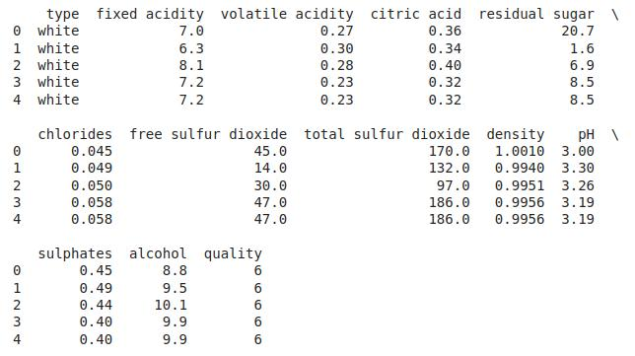


First Five rows of the Dataset

Slide 5
We need to check the number of null values in the dataset column wise.
We use EDA which is an approach used to analyze data using visual techniques.

Slide 6
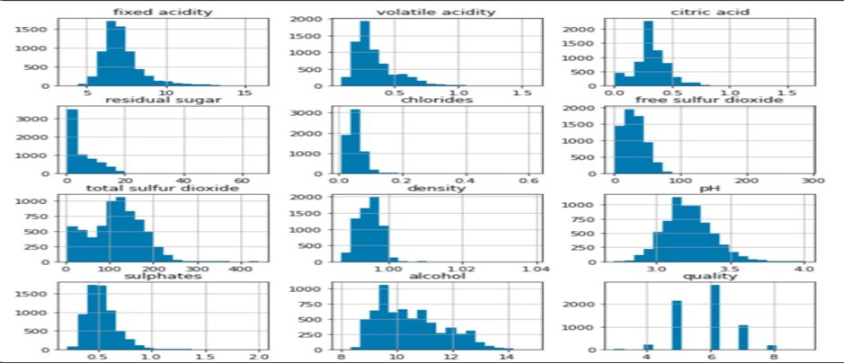
A histogram is drawn to visualize the distribution of the data to the continues values in the columns of the dataset.

Slide 7
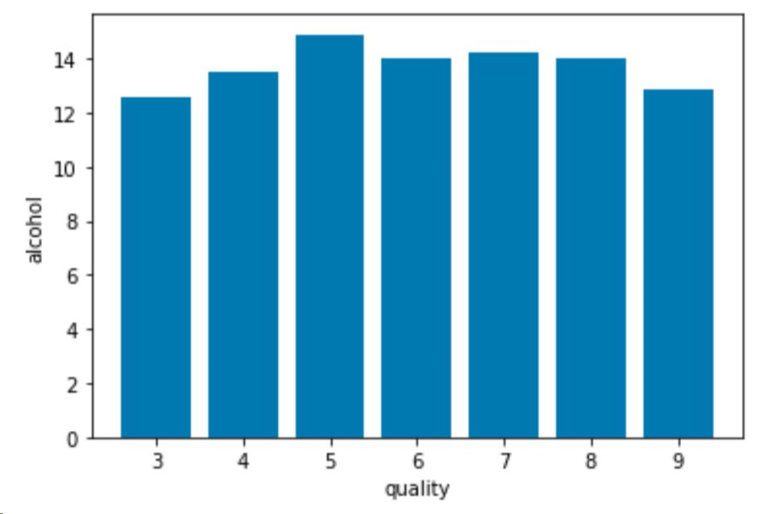
A bar graph should be plotted to check what value of alcohol can be able to make change in the quality i.e. this count plot is drawn to visualize the number data for each quality of wine.
Output :

Slide 8
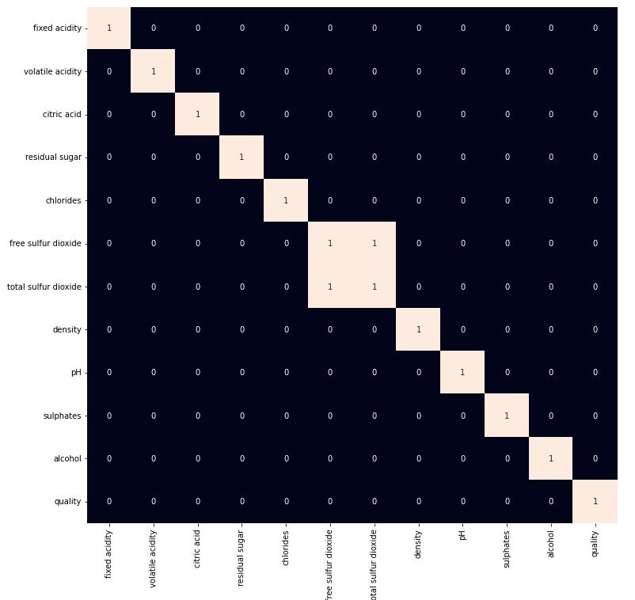
Correlation Plots
From this heat map, It is evident that ‘total Sulphur dioxide’ & ‘free Sulphur dioxide’ are highly correlated features.
Hence, these should be removed.

Slide 9
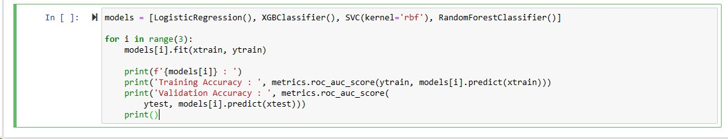
Following models are used :
Logistic Regression
XGBClassifier
Support Vector Classifier

Slide 10
Model Selection
By comparing the accuracy of various classification models, we came to a conclusion that XGBClassifier has the highest accuracy than Logistic Regression and SVC.
Logistic Regression : 0.70
XGBClassifier : 0.97
Support Vector Classifier : 0.70

Slide 11
THANK YOU

